Slide 1
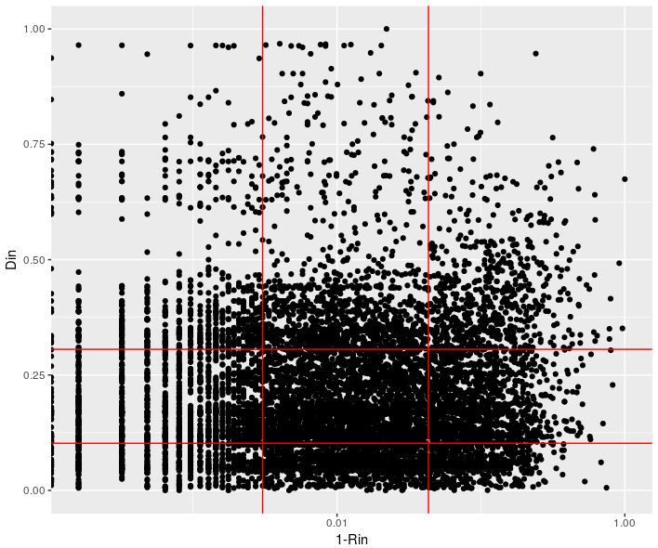
Indices:
D75R75
D75R25
D25R75
D25R25
AVG

Slide 2

Mapping the global functional rarity

Slide 3
Mapping the global functional rarity

Slide 4
Passage à 10km
0
0

Slide 5
Delta Global Land Change (1982-2016)
Tree Canopy
Short Vegetation
Bare ground

Slide 6
Protected areas

Slide 7
Conflict and country

